Slide 1
KHATRA ADIBASI MAHAVIDYALAYA P.O- Khatra, Dist.-Bankura, West Bengal, Pin-722140 Name of the Teacher- TITHI ROY Class- Semester – II Subject- Physical Education Course Tittle: ANATOMY, PHYSIOLOGY AND PHYSIOLOGY OF EXERCISE AND
SPORTS
Topic- THE MUSCULAR SYSTEM
Session: 2021-22

Slide 2
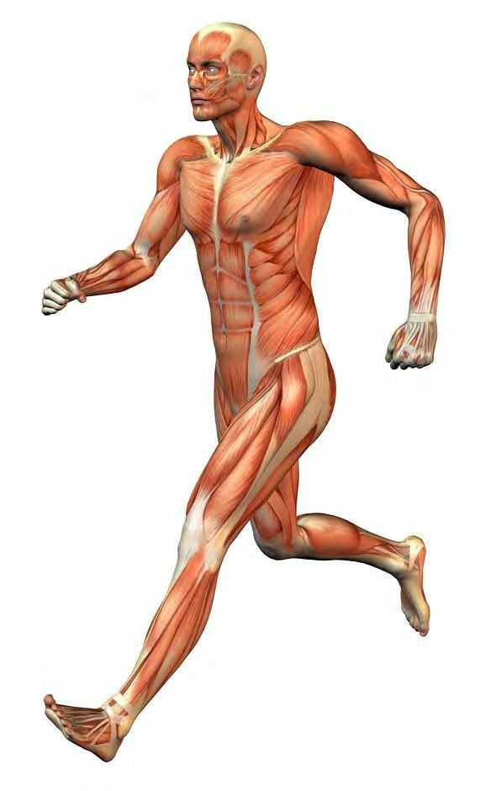
THE MUSCULAR SYSTEM
COMPILED BY HOWIE BAUM
1

Slide 3
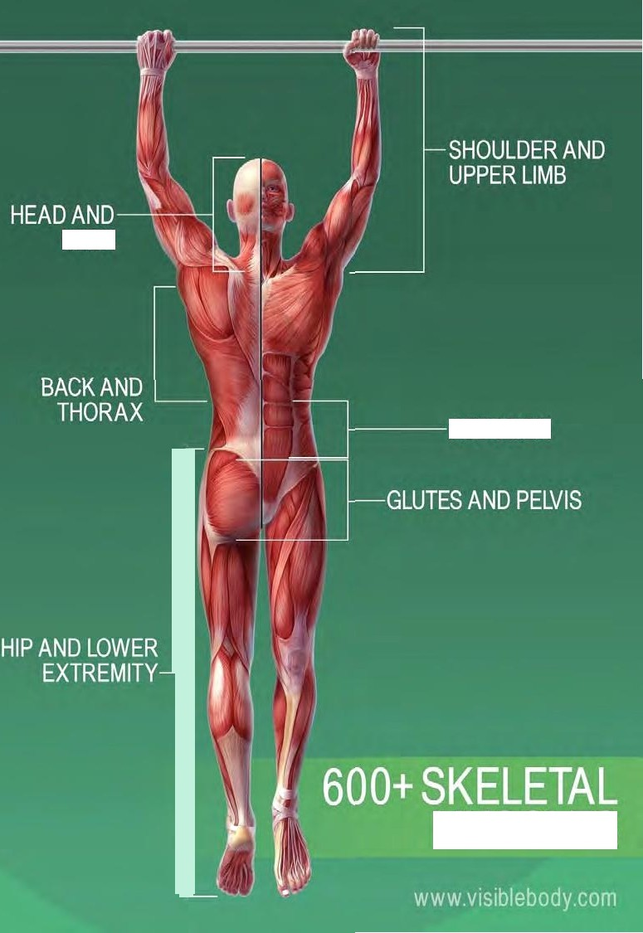
NECK
ABDOMEN
MUSCLES

Slide 4
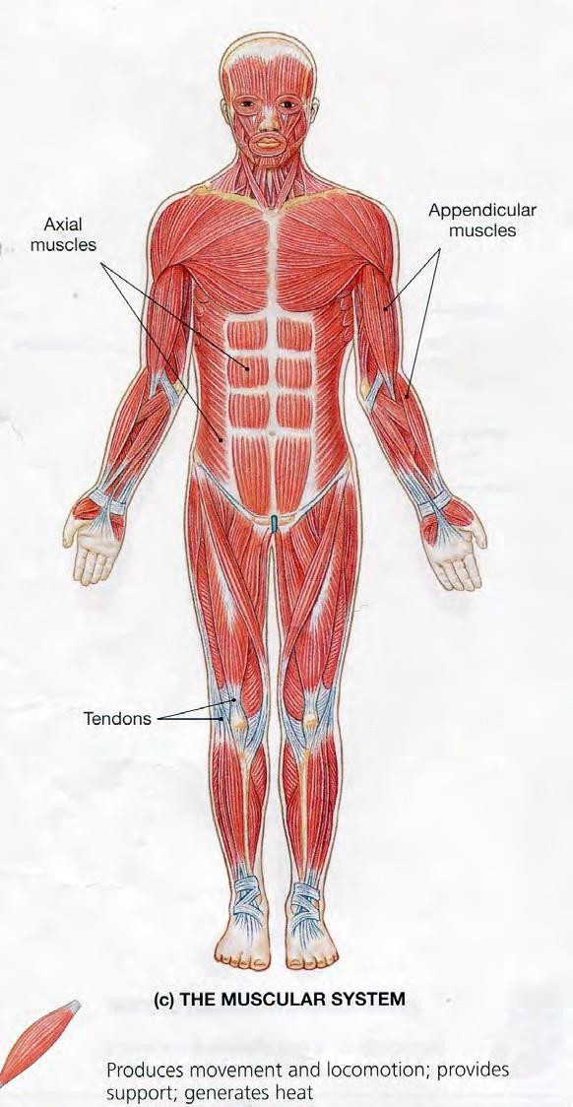
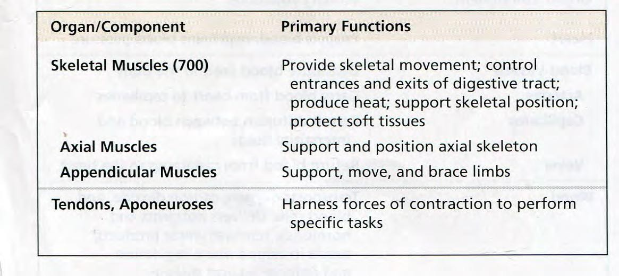
Muscles make up the bulk of the body and account for 1/3 of its weight.!!
Blood vessels and nerves run to every muscle, helping control and regulate each muscle’s function.

Slide 5
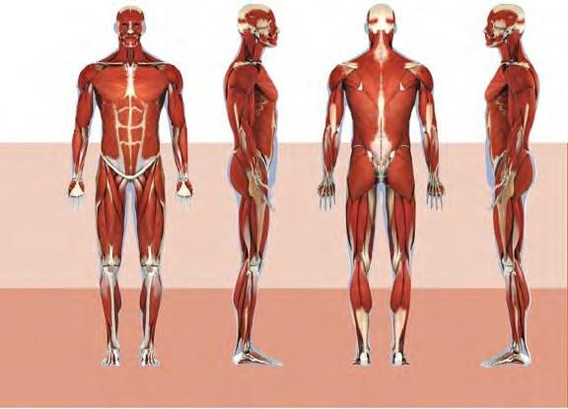

Slide 6
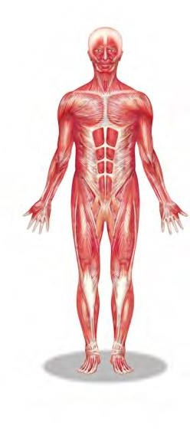
The muscular system creates body heat
and also moves the:
Bones of the Skeletal system
Food through Digestive system
Blood through the Circulatory system
Fluids through the Excretory system

Slide 7
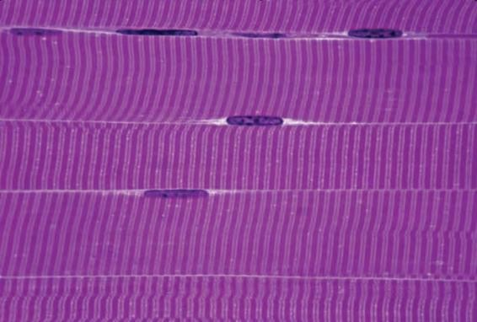
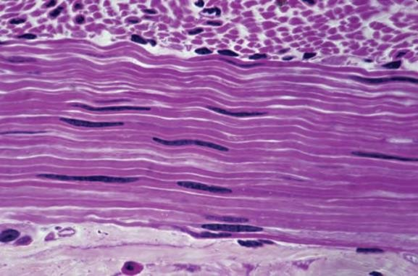
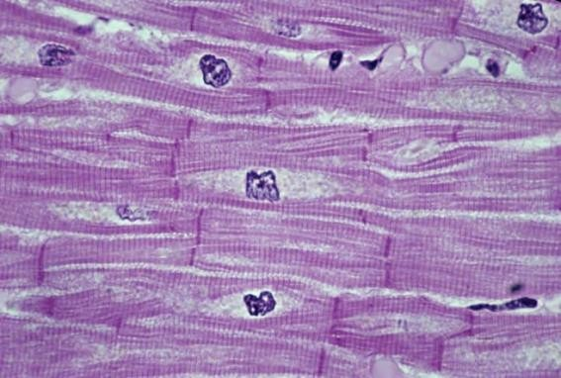
MUSCLE TISSUE
The body has 3 main types of muscle tissue
1) Skeletal, 2) Smooth, and 3) Cardiac
SKELETAL MUSCLE
SMOOTH MUSCLE
CARDIAC MUSCLE

Slide 8
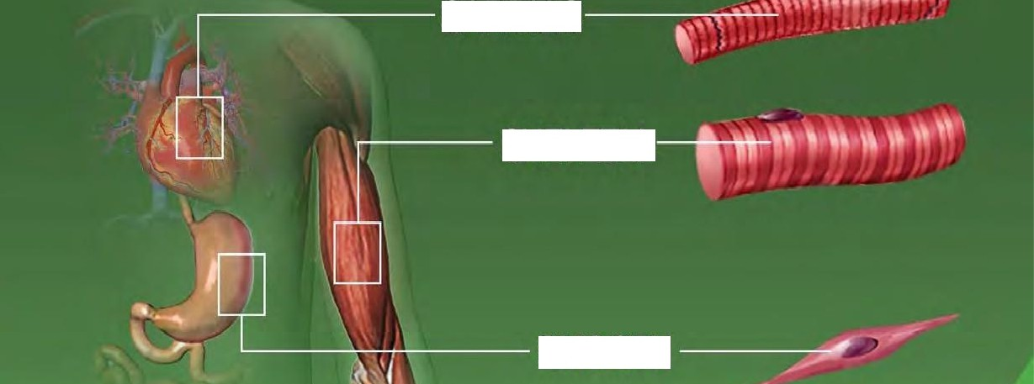
CARDIAC
SKELETAL
SMOOTH

Slide 9
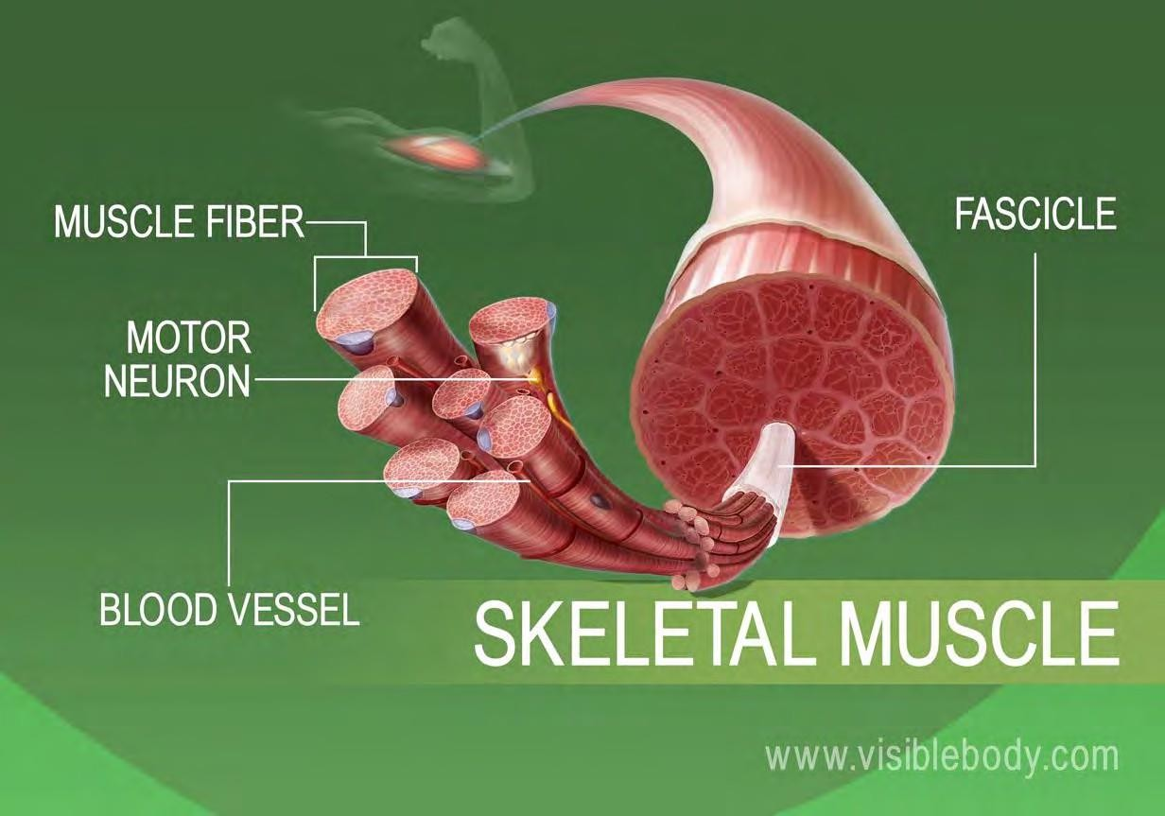
Skeletal muscles attach to and move bones by contracting and relaxing in response to voluntary messages from the nervous system.
Skeletal muscle tissue is composed of long cells called muscle fibers that have a striated appearance.
Muscle fibers are organized into bundles supplied by blood vessels and innervated by motor neurons.

Slide 10
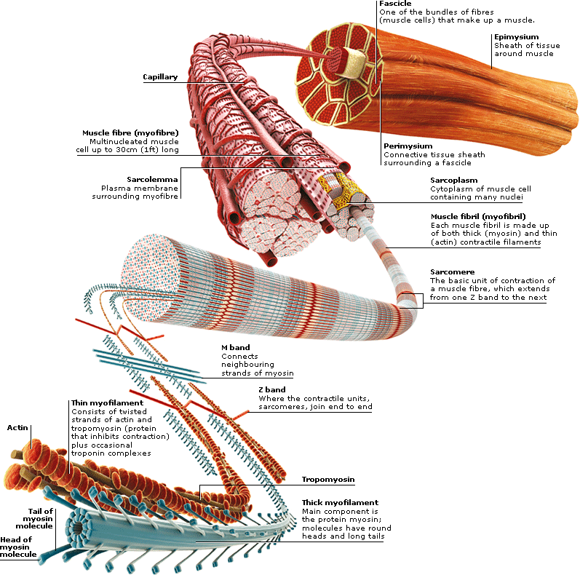
Muscle structure
Skeletal (striated or voluntary) muscle consists of densely packed groups of hugely elongated cells known as myofibers.
These are grouped into bundles (fascicles).
A typical myofiber is 2–3 centimeters ( 3/4–1 1/5 in) long and 0.05millimeters (1/500 inch) in diameter and is composed of narrower structures – myofibrils. These contain thick and thin myofilaments made up mainly of the proteins actin and myosin. Numerous capillaries keep the muscle supplied with the oxygen and glucose needed to fuel contraction.

Slide 11
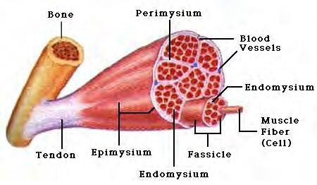
Skeletal Muscles
Skeletal muscles attach to bones by tendons (connective tissue) and enable movement.
Skeletal muscles are mostly voluntary

Slide 12
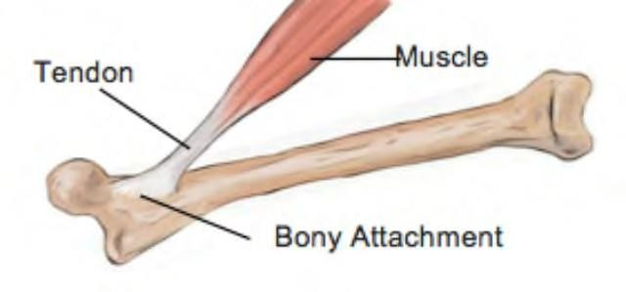
The typical male body contains approximately 640 muscles, which compose around two-fifths of its weight.
The same number in a female body make up a slightly smaller proportion.
A typical muscle spans a joint and tapers at each end into a fibrous tendon anchored to a bone. Some muscles divide to attach to different bones.

Slide 13
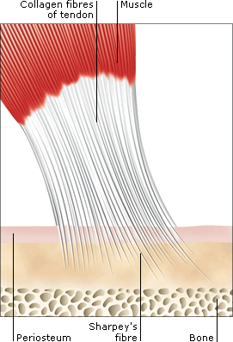
TENDONS
Tendons are tough, fibrous cords of connective tissue that link skeletal muscles to bones.
Within them, Sharpey’s fibers pass through the bone covering (periosteum) to embed in the bone.
Tendons in the hands and feet are enclosed in self- lubricating sheaths to protect them from rubbing against the bones.
From the hand bones, tendons extend upwards to muscles near the elbow.

Slide 14
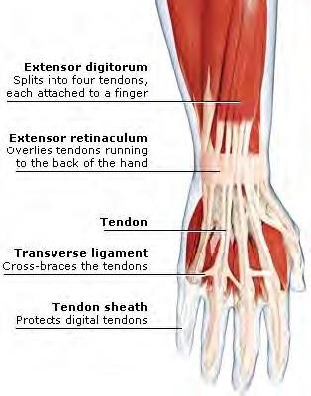
Tendons and Tendon Sheaths in the hand.

Slide 15
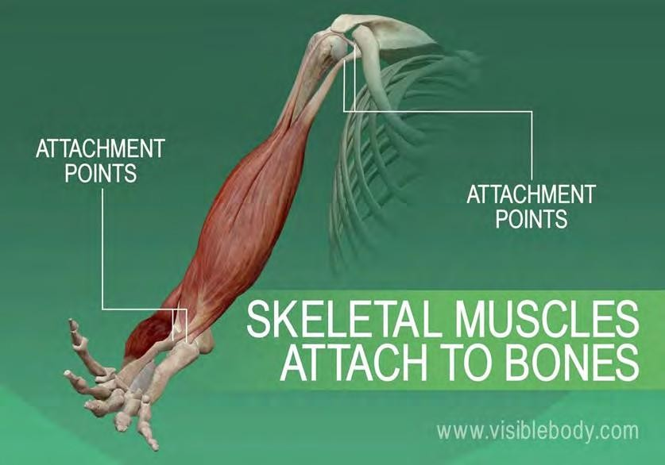
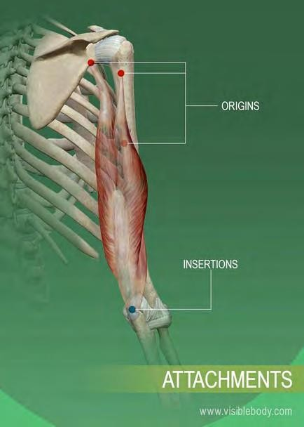
SKELETAL MUSCLES
Skeletal muscles are also known as voluntary muscles, since we control their actions at will, and as striated muscles, from their microscopic appearance.
In the muscular system, skeletal muscles are connected to the skeleton, either to bone or to connective tissues such as ligaments.
Muscles are always attached at two or more places.
When the muscle contracts, the attachment points are pulled closer together; when it relaxes, the attachment points move apart.

Slide 16
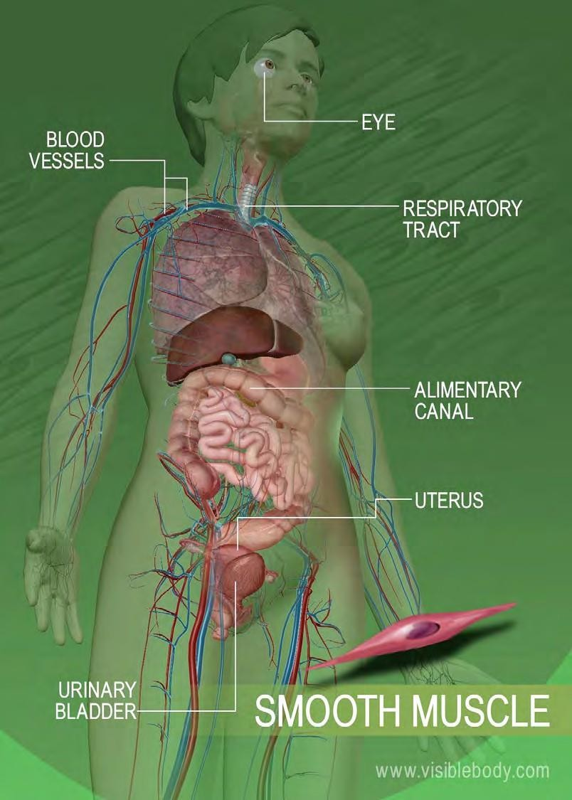
A second type is smooth muscle, in the walls of body parts such as the airways, stomach, Alimentary canal, and blood vessels.
This is called involuntary muscle, because it works automatically rather than under conscious control, or smooth muscle, from its magnified appearance

Slide 17
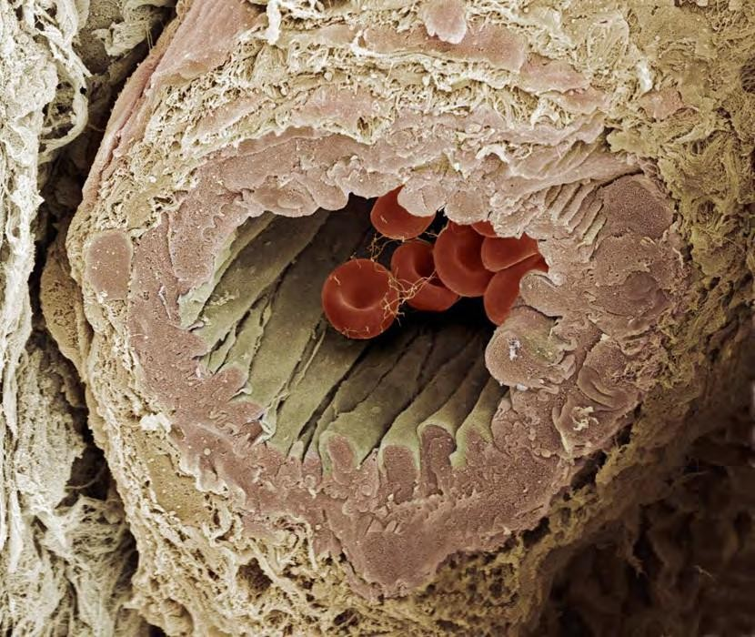
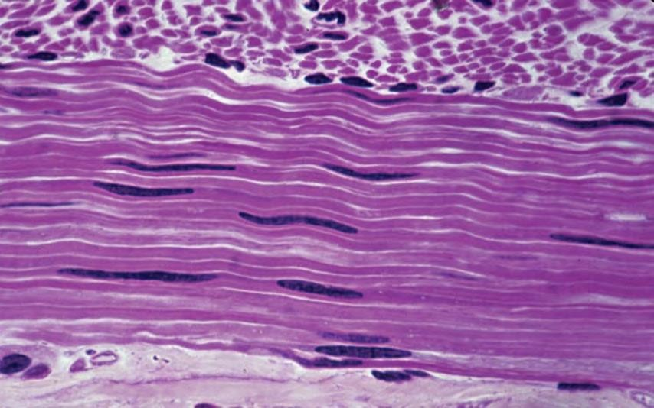
Smooth muscle lines organs and is involuntary.
moves food through digestive organs
empties liquid from the bladder
controls width of the blood vessels
Smooth muscle around this artery allows the artery to regulate blood flow by shrinking and expanding.
SMOOTH MUSCLE

Slide 18
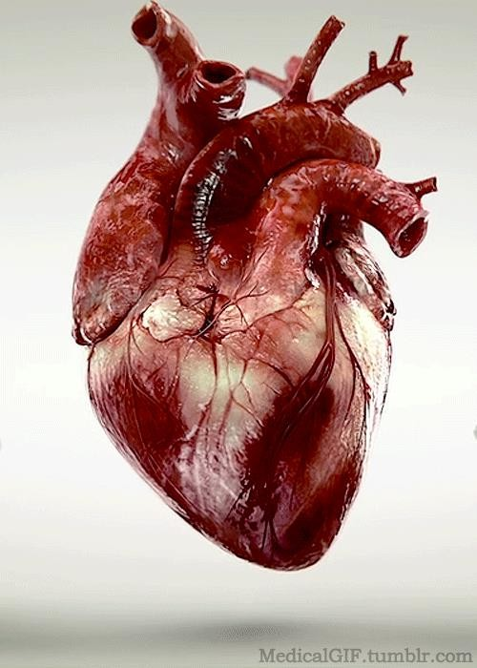
The third type is cardiac muscle, making up the walls of the heart.
It is part of both the Muscular System and the Circulatory System.
It is responsible for circulating blood throughout the body.
It has its own pacemaker for rhythmic beating.

Slide 19
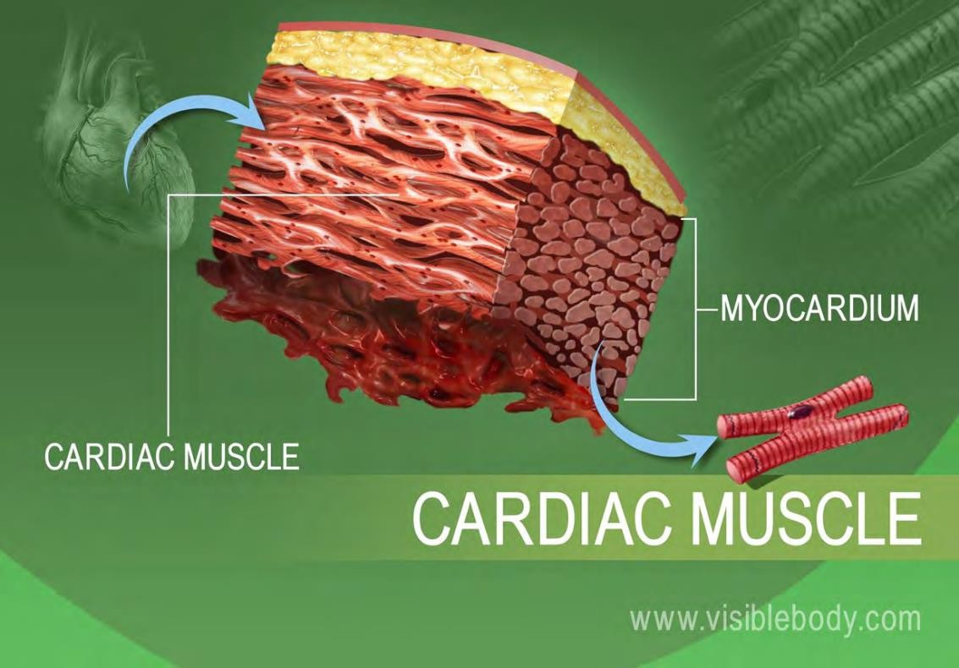
The heart wall is composed of three layers.
The middle layer, the myocardium, is responsible for the heart’s pumping action.
Cardiac muscle, found only in the myocardium, contracts in response to signals from the cardiac conduction system to make the heart beat.
Cardiac muscle is made from cells called cardiocytes.

Slide 20
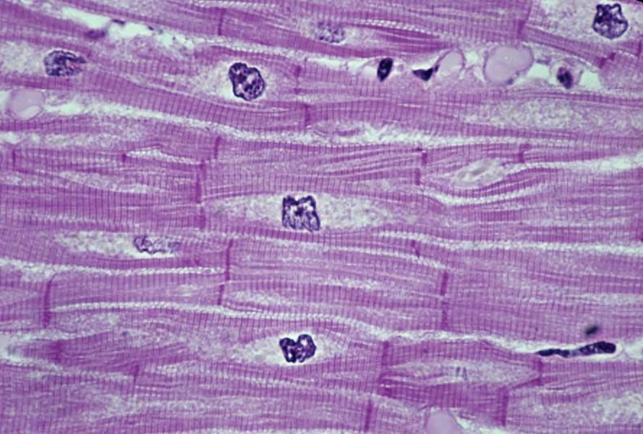
Cardiac muscle is found only in the heart.
pumps blood throughout body
contains more mitochondria than skeletal muscle cells
CARDIAC MUSCLE

Slide 21
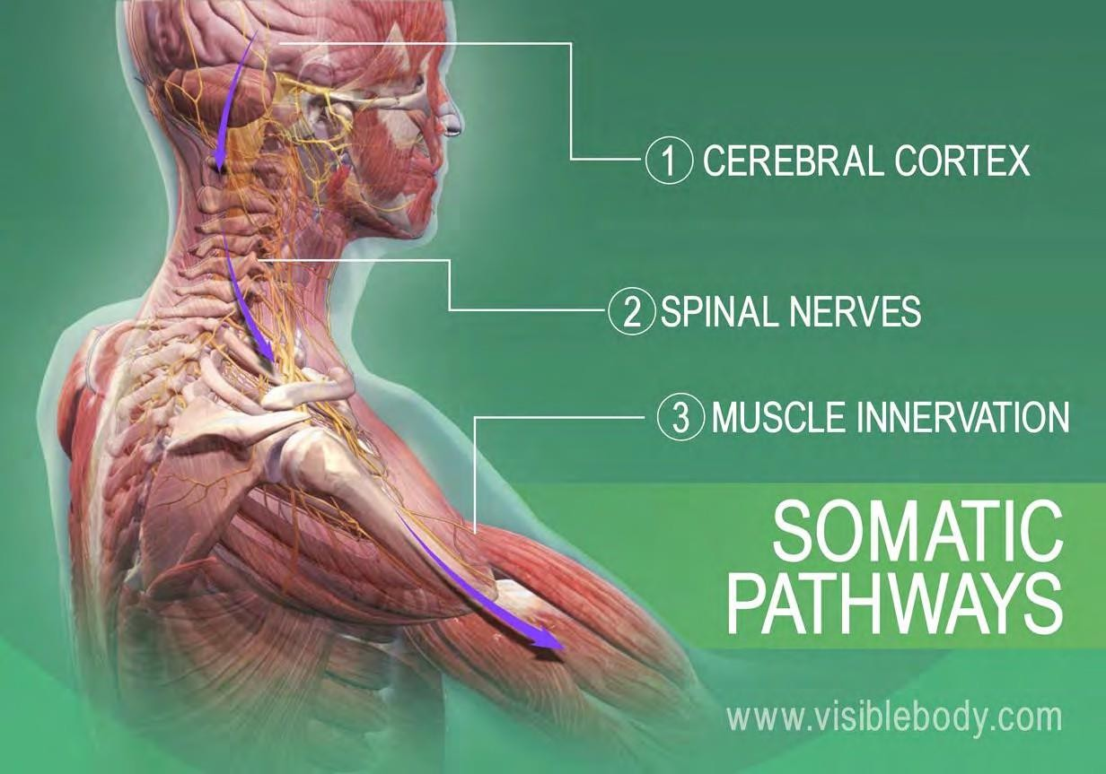
HOW DO SKELETAL MUSCLES MOVE?
It happens when the muscular system and the nervous system work together: Somatic signals are sent from the cerebral cortex to nerves associated with specific skeletal muscles.
Most signals travel through spinal nerves that connect with nerves that innervate skeletal muscles throughout the body.

Slide 22
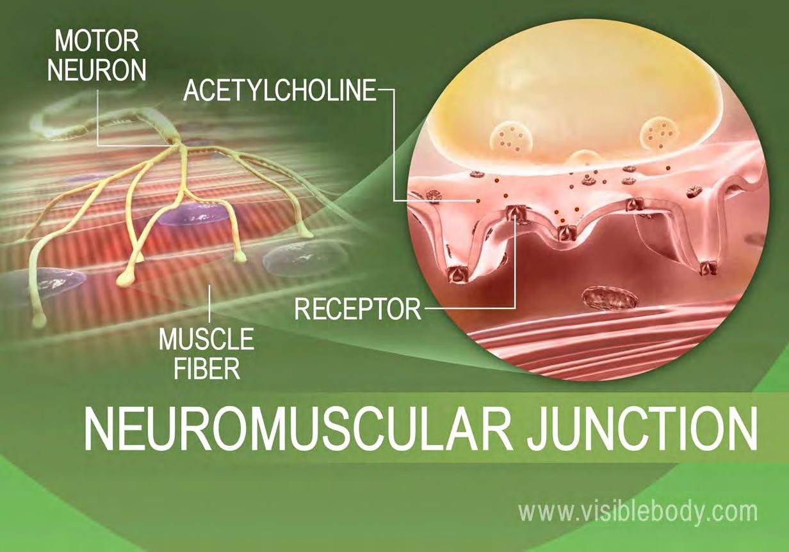
Muscle contraction begins when the nervous system generates a signal.
The signal, an impulse called an action potential, travels through a type of nerve cell called a motor neuron.
The neuromuscular junction is the name of the place where the motor neuron reaches a muscle cell.
Skeletal muscle tissue is composed of cells called muscle fibers.

Slide 23
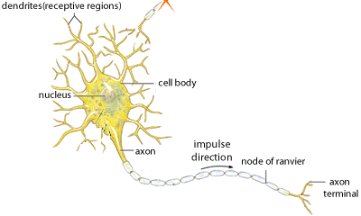
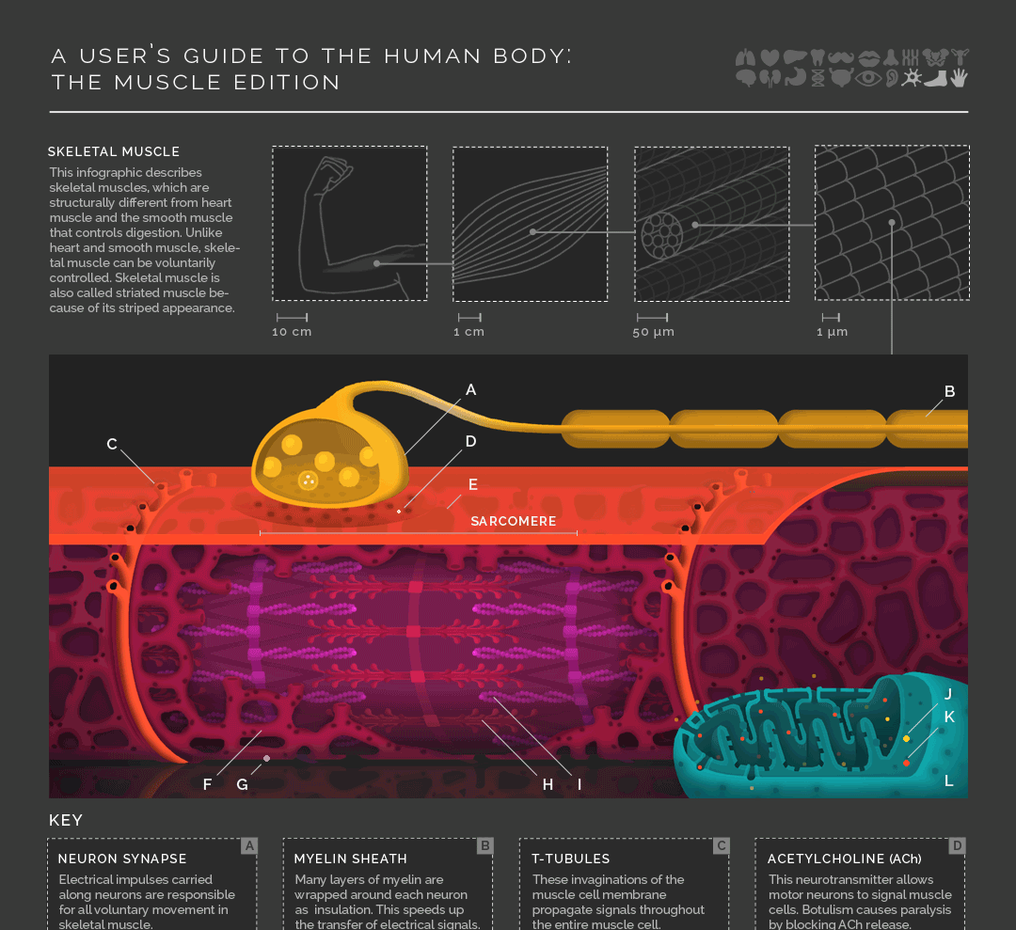
The top image is of a brain neuron sending an electronic signal to a motor neuron, shown below.
When the nervous system signal reaches the neuromuscular junction a chemical message is released by the motor neuron.
The chemical message, a neurotransmitter called acetylcholine, binds to receptors on the outside of the muscle fiber. That starts a chemical reaction within the muscle, to make it contract.

Slide 24
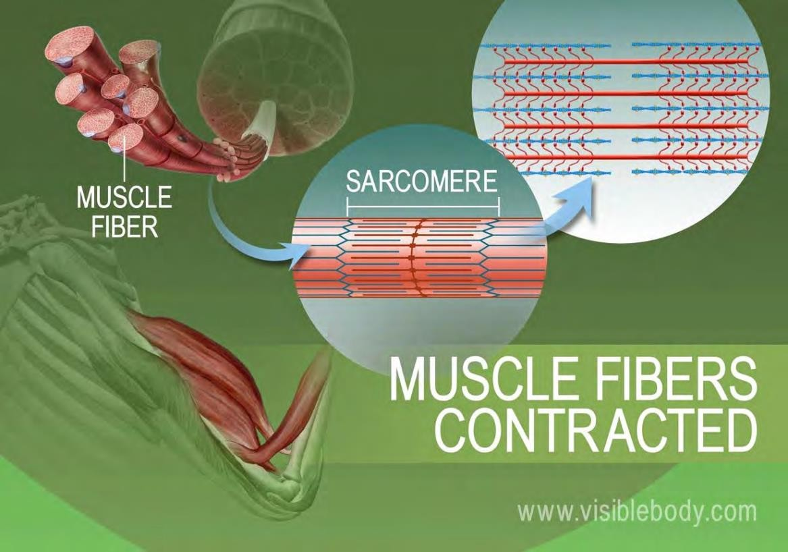
A multistep molecular process within the muscle fiber begins when acetylcholine binds to receptors on the muscle fiber membrane.
The proteins inside muscle fibers are organized into long chains that can interact with each other, reorganizing to shorten and relax.
When acetylcholine reaches receptors on the membranes of muscle fibers, membrane channels open and the process that contracts a relaxed muscle fibers begins.

Slide 25
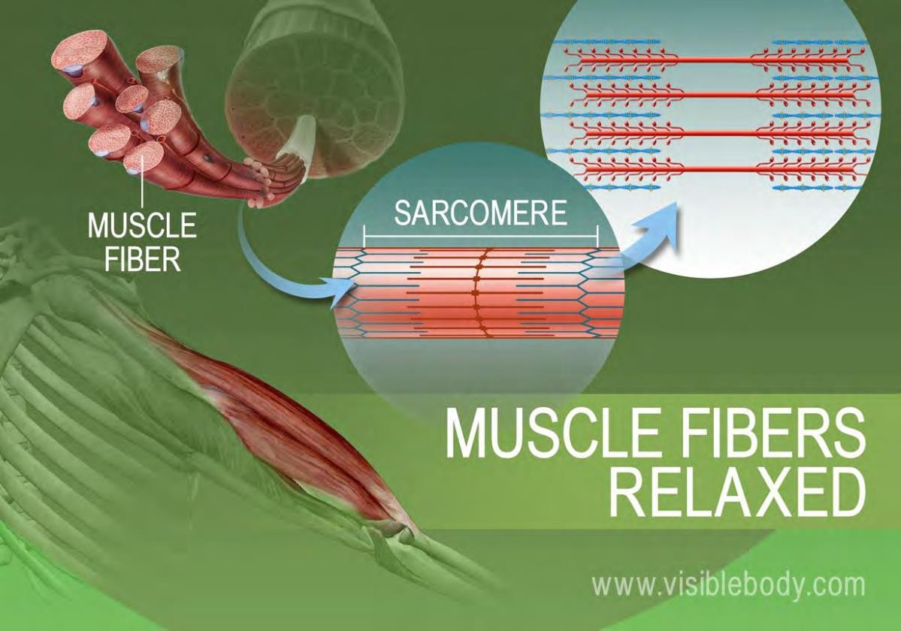
When the stimulation of the motor neuron providing the impulse to the muscle fibers stops, the chemical reaction that causes the rearrangement of the muscle fibers proteins is stopped.
This reverses the chemical processes in the muscle fibers and the muscle relaxes.

Slide 26
Muscle pairs:
Muscles are grouped together in pairs on your skeleton
Muscles can’t push - they only contract and pull the bones to which they are anchored.
Relaxed or contracted:
When one muscle of a pair contracts, the other relaxes
Pulling muscles:
Skeletal muscles only pull in one direction. For this reason they always come in pairs. When one muscle in a pair contracts, to bend a joint for example, its partner then contracts and pulls in the opposite direction to straighten the joint out again.

Slide 27
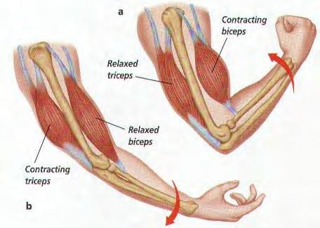
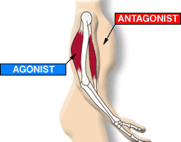
An example of how the 2 sets of arm muscles move to pull the bone, on one side and then the other, depending on how the arm is intended to move.

Slide 28
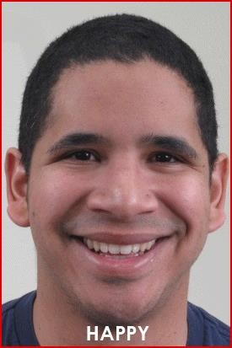
FACIAL MUSCLES AND THE SHOWING OF OUR EMOTIONS
To steady and move the head and to move facial features such as the eyebrows, eyelids, and lips, the muscles of the face, head and neck interact.
The musculature involved is highly complex, allowing for a huge range of facial expressions.

Slide 29
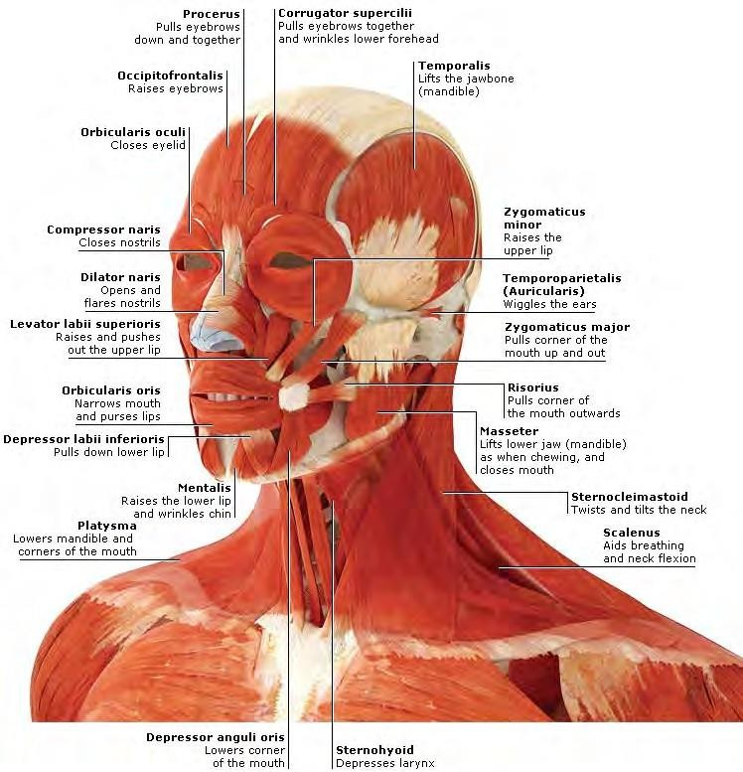
FACIAL MUSCLES
Some facial muscles are anchored to bones.
Others are joined to tendons or to dense, sheet-like clusters of fibrous connective tissue called aponeuroses.
This means, that some facial muscles are joined to each other.
Many of these muscles have their other end inserted into deeper layers of the skin. The advantage of this complex system is that even a slight degree of muscle contraction produces movement of the face’s skin, which reveals itself as a show of expression or emotion.

Slide 30
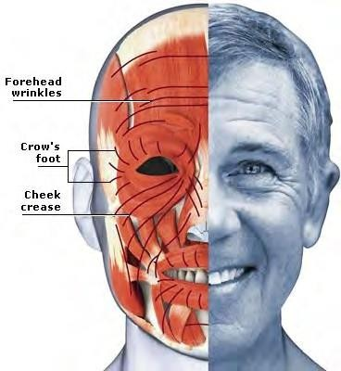
LAUGHTER LINES
Healthy young skin contains resilient fibers made of the protein elastin which help it return to its original position, for example, after smiling.
With increasing age, the elastin degenerates and the skin’s dermis becomes more loosely attached to the muscle beneath.
This causes wrinkles as the skin can no longer stretch or shrink easily.
Initially “crow’s feet” radiate from the corners of the eyes. These are followed by lines around the brow and mouth, in front of the ears, between the eyebrows, on the chin and bridge of the nose.

Slide 31
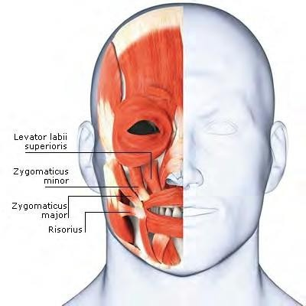
Facial expressions
Facial expressions are among our most important methods of non-verbal communication.
The facial musculature enables many subtle nuances of appearance that convey an enormous variety of emotions.
A smile often indicates pleasure, and a frown the opposite – but not always.
The smile is a highly ambiguous and versatile expression, which can also convey relief or pity, or widen into a grin for sarcastic disapproval.
SMILING

Slide 32
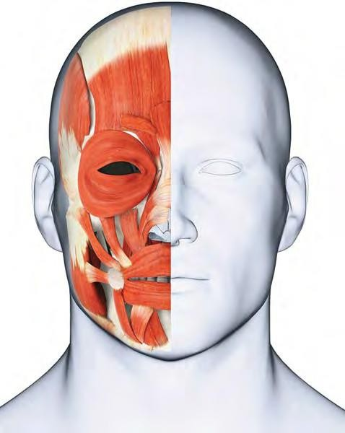
RELAXED NEUTRAL POSITION

Slide 33
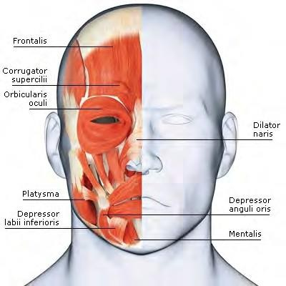
Likewise, a frown can articulate various feelings, including disappointment and confusion.
In addition to the mouth, other regions of the face are involved to add shades of meaning.

Slide 34
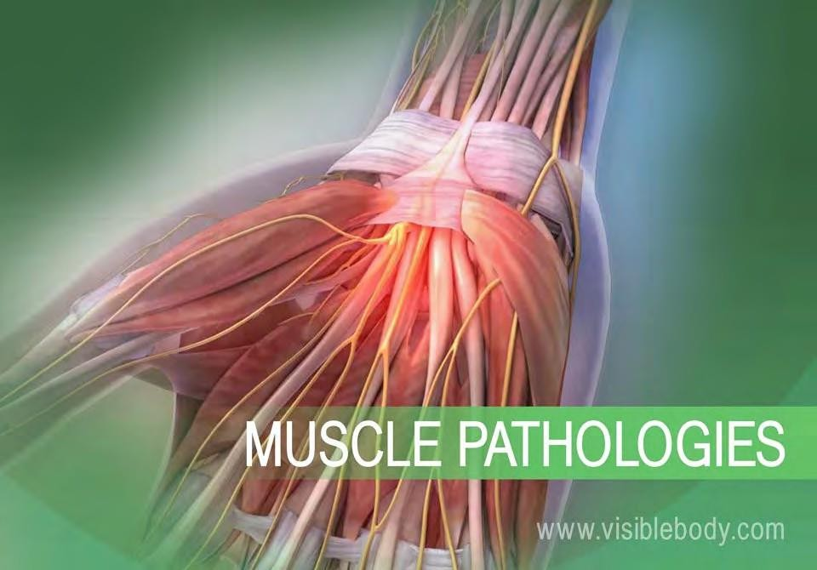
Muscular System Pathologies: Common Disorders and Conditions
Muscles allow us to move, but sometimes the wear and tear that comes from moving our bodies can lead to disorders of the muscular system.
Below are some of the most common muscular pathologies.

Slide 35
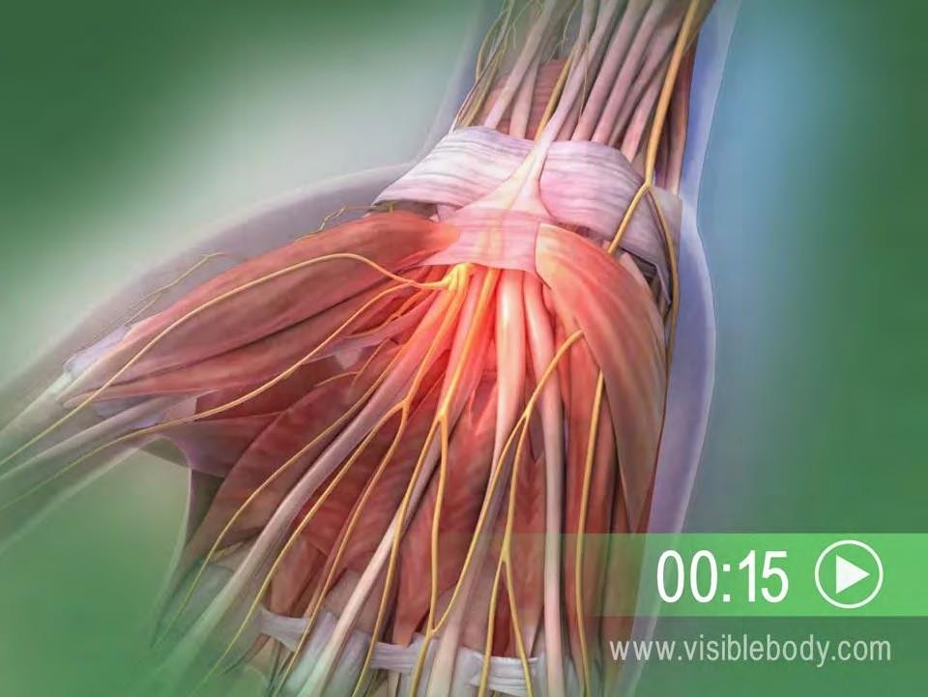
The carpal tunnel is the passageway in the wrist where the median nerve and flexor tendons pass through a narrow opening.
Carpal tunnel syndrome, which is also called median nerve compression, occurs when the tendons become inflamed, causing compression of the median nerve.
Symptoms include pain, numbness, and eventual weakness in the hand. Carpal tunnel syndrome can occur for a variety of reasons including hereditary predisposition, repetitive movements, diabetes, or thyroid disorders.

Slide 36
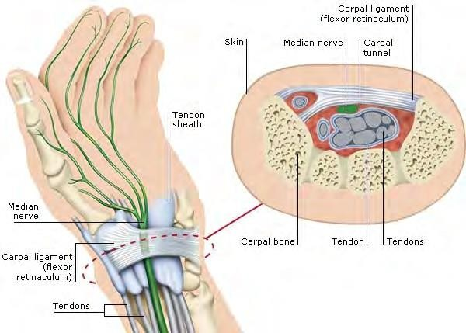
The carpal tunnel is between the carpal ligament (flexor retinaculum), which restrains and aligns the tendons that move the hand and fingers, and the carpal bones of the wrist. Tendons in their sheaths slide through this passageway, adjacent to the median nerve.

Slide 37
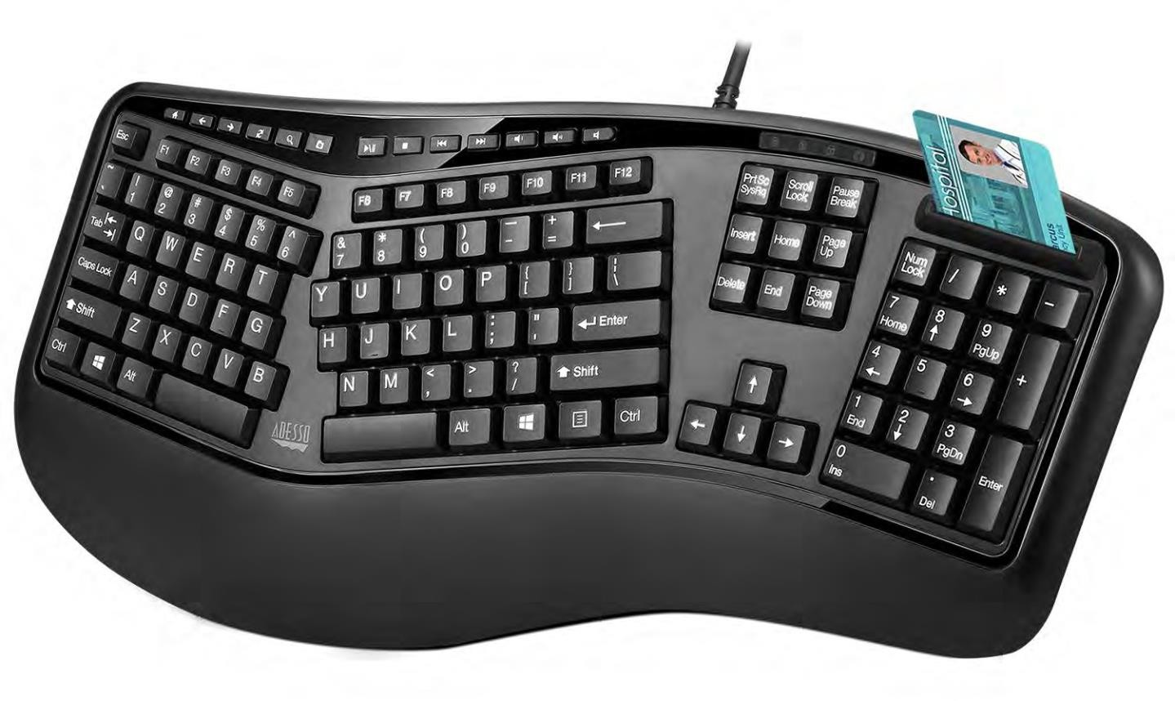
If you do a lot of typing or other repetitive motions over a long period of time, you can get Carpal Tunnel Syndrome in one or both wrists.
To minimize the problem if you type a lot, an Ergonomic keyboard is recommended.

Slide 38
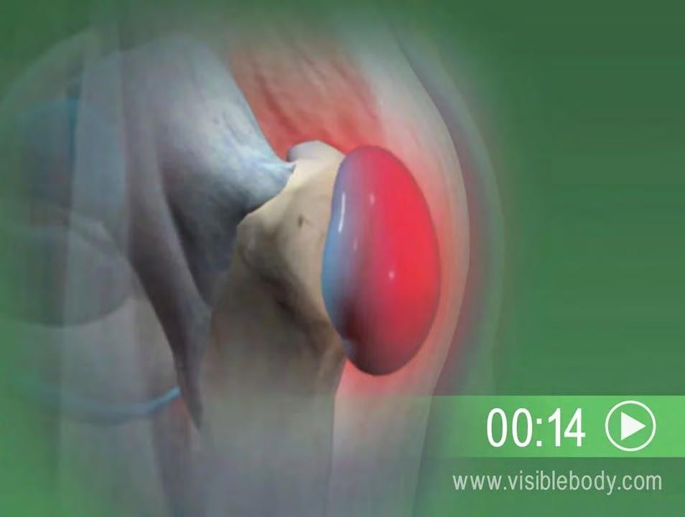
BURSITIS
Bursae are small fluid- filled sacs that cushion the bones, tendons, and muscles near the joints.
Bursitis occurs when bursae become red and inflamed, causing pain.
This condition often occurs near joints that perform frequent repetitive motion, such as the shoulder, elbow, hip, and knee.

Slide 39
And Finally, Some Questions
Muscle Trivia…
How many muscles are in the average adult
human body?
Approximately 640
What is the strongest muscle in the body?
Debatable, but many say the masseter (jaw).
What is the largest muscle in the body?
The gluteus maximus in your rear end

